Slide 1

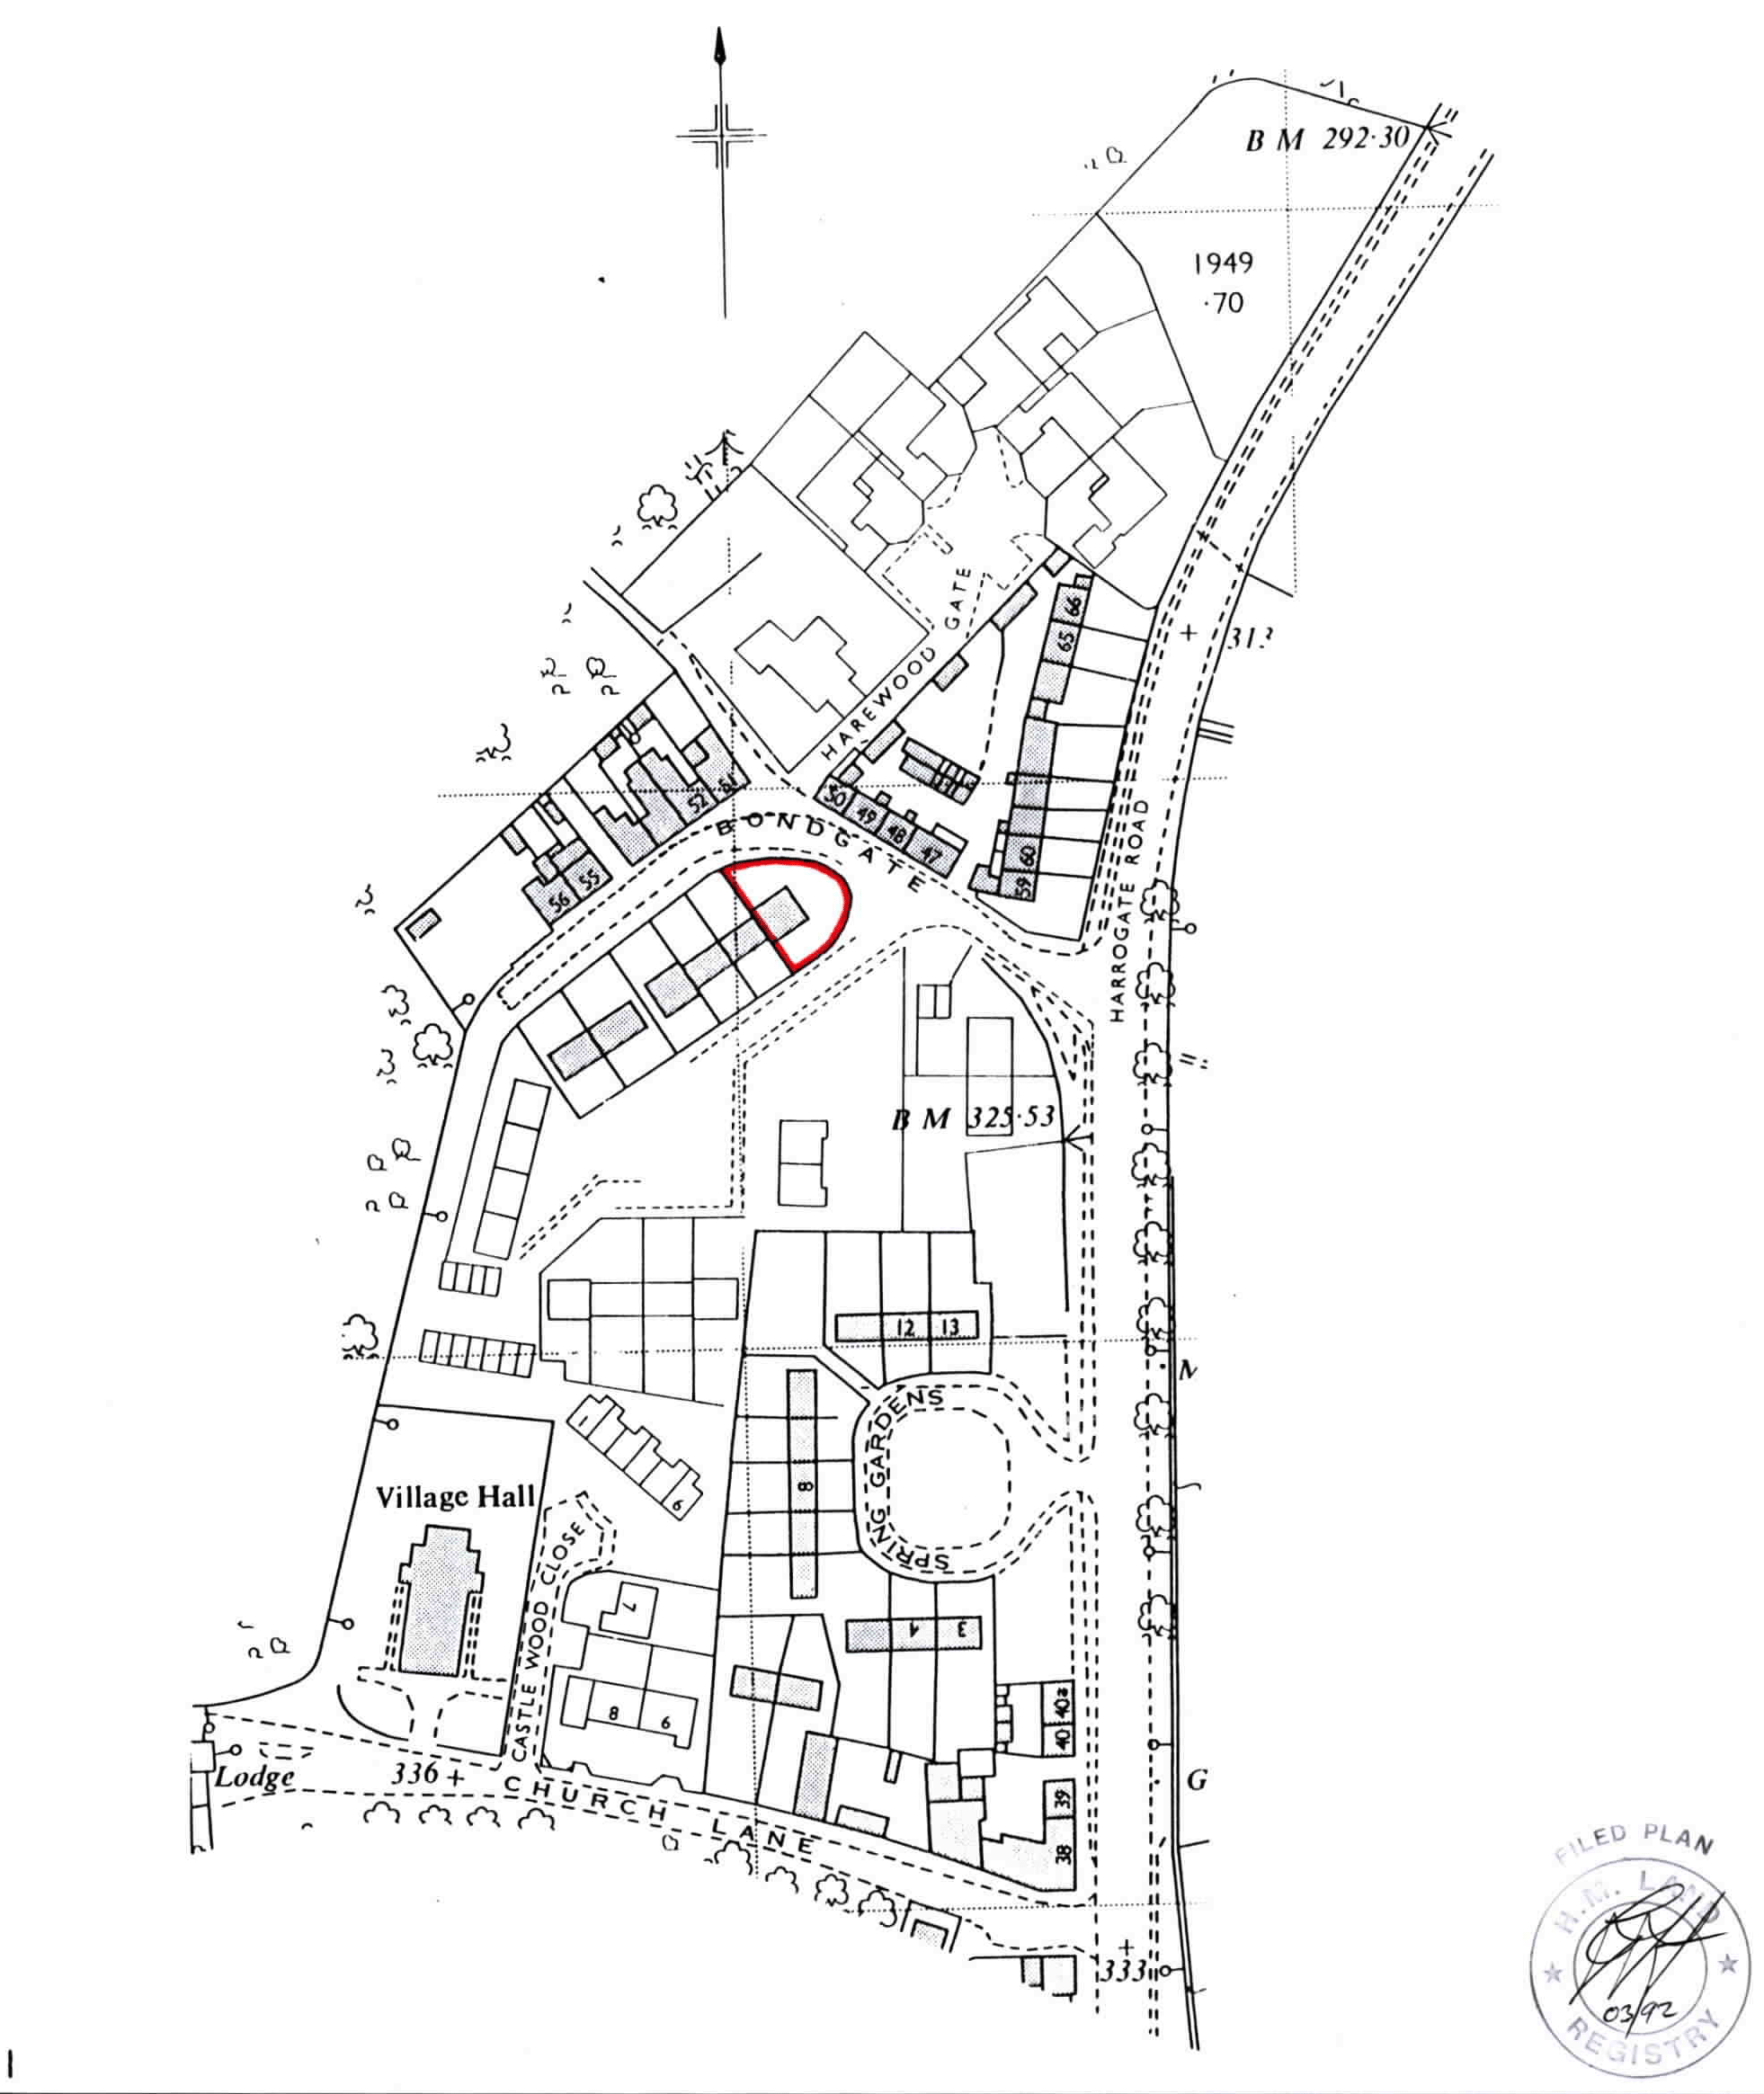
February 2024
Asking Price Evaluation
2 Bondgate, Harewood LS17 9LN

Slide 2
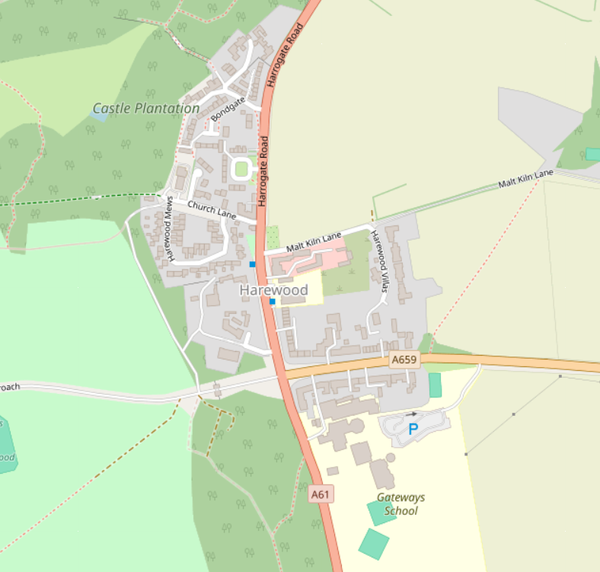
February 2024
Yorkshire Property Report has been instructed by Mrs X XXXXX to review of 2 Bondgate, Harewood LS17 9LN. This report will:
Evaluate whether the asking price is fair
MARKET VALUE
1.1
2 Bondgate was last sold on 08.02.2006 for £140,000. Using Nationwide’s house price calculator (which adjusts for location), the property would now be worth around £197,538.
1.2
We have done our own thorough review of the recent sales in Harewood. Direct comparable homes were difficult to find, and in the last 12 months, only four properties within a 0.5mile radius have sold (see below).
1
2
3
4
2

Slide 3
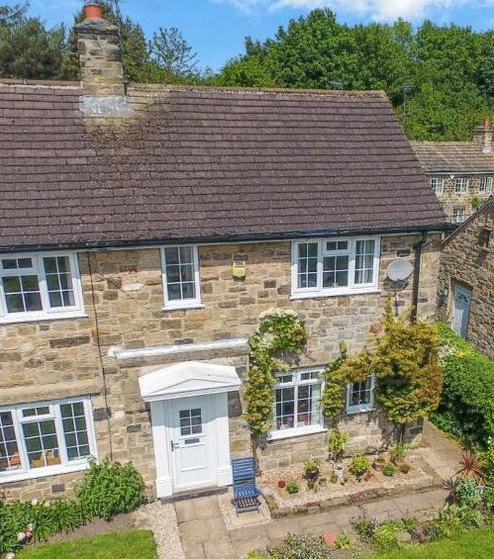
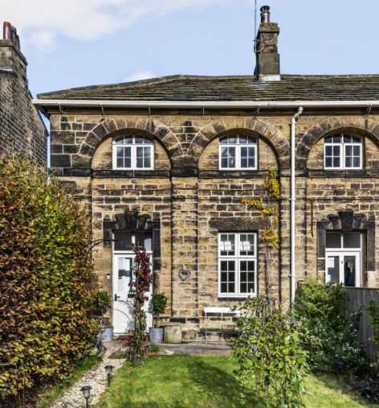
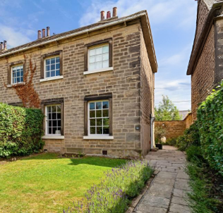
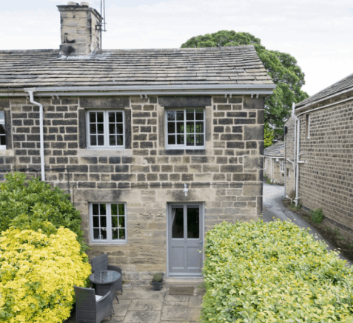
February 2024
1.
2.
Address:
Type:
Date Sold:
Sold For:
Size:
£ / Sq ft:
10 Bondgate, LS17 9LN
2B Semi Detached
12.02.24
£365,000
916 sq ft
£398.47
Address:
Type:
Date Sold:
Sold For:
Size:
£ / Sq ft:
10 The Avenue, LS17 9LD
3B End Terrace
31.05.23
£420,000
1,005 sq ft
£417.91
3.
4.
Address:
Type:
Date Sold:
Sold For:
Size:
£ / Sq ft:
91 The Avenue, LS17 9LD
4B End Terrace
28.02.24
£650,000
2,371 sq ft
£274.14
Address:
Type:
Date Sold:
Sold For:
Size:
£ / Sq ft:
28 Harrogate Road, LS17 9LH
3B End Terrace
27.03.23
£303,320
1,005 sq ft
£382.98
3

Slide 4
February 2024
1.3
Property 1 (10 Bondgate) is the best comparison available. It's the closest in size to 2 Bondgate (which is 368 sq ft) and sits on the same street.
However, the two properties aren't identical. While 2 Bondgate is smaller and will cost less overall, smaller homes typically sell for more per square foot than larger ones. This is because buyers pay a premium for entry-level homes in popular areas. Generally, smaller homes cost 10% to 30% more per square foot than larger homes of similar quality in the same location.
Based on this, a fair price for 2 Bondgate would be around £199,952.
This is well below the current asking price of £240,000. However, homes like 2 Bondgate are rare in this area, which means buyers will likely pay over the odds to secure one. With this in mind, an offer of £210,000 would be reasonable.
E N D O F R E P O R T
4

